Slide 1
MULTI-CUT REBAR(16)
Advisor : Prof. K.C.Chang
Presenters : You-Ran Nai
Notes:
Try 講清楚脈絡

Slide 2
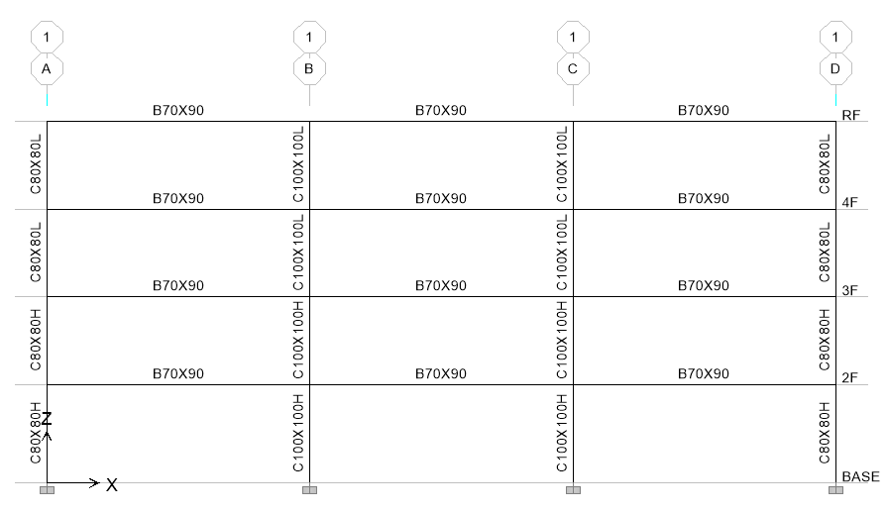
Case Study

Slide 3
Information

Slide 4
Design Earthquake

Slide 5
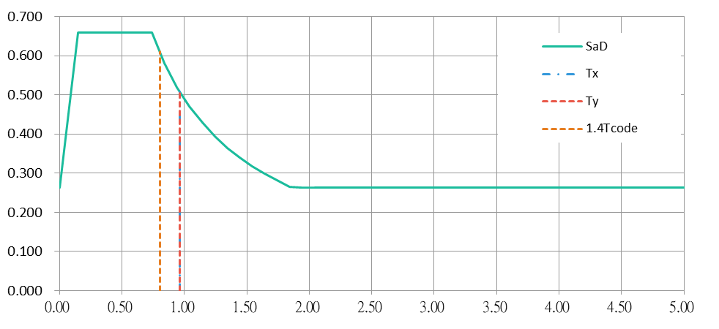
Design Earthquake

Slide 6
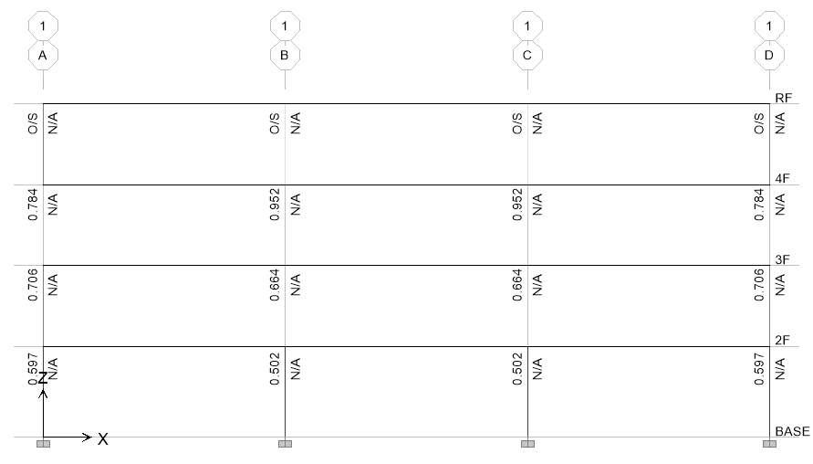
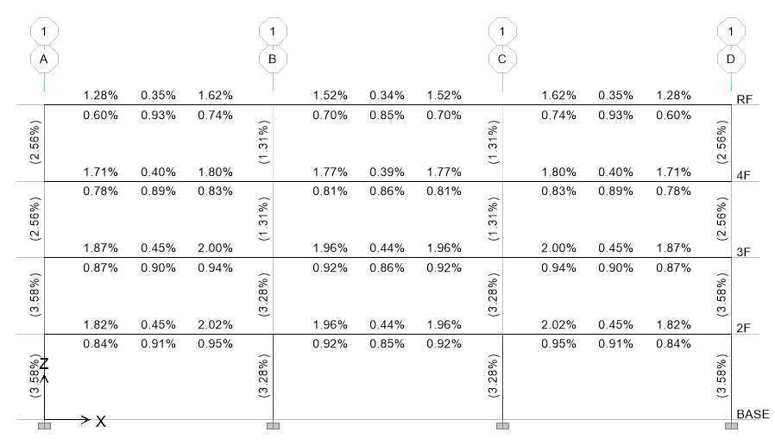
強柱弱梁
鋼筋比

Slide 7
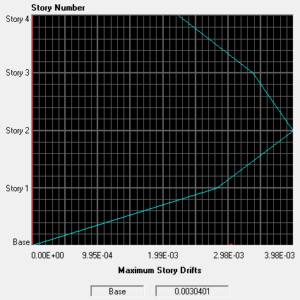
Story Drift
0.32%

Slide 8

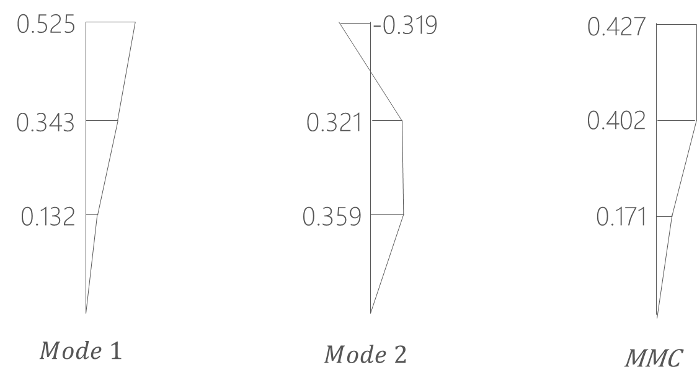
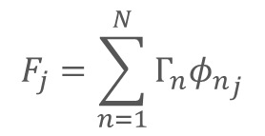
Pushover Load Pattern
Triangle
Multi-Modes Combination
Modal Pushover Analysis
$$F_{j}=\sum_{n=1}^{N}{Γ_{n}{φ_{n}}_{j}}$$
SRSS
Notes:
定義非線性驗證的邊界

Slide 9
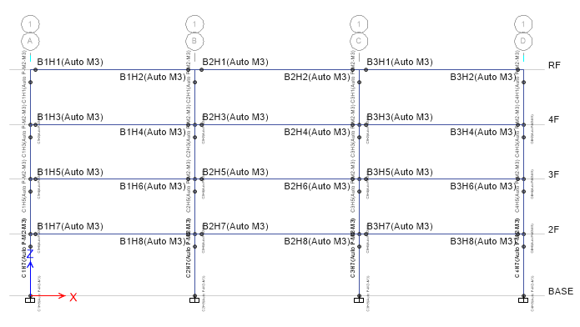
Hinges Only On Two Ends

Slide 10
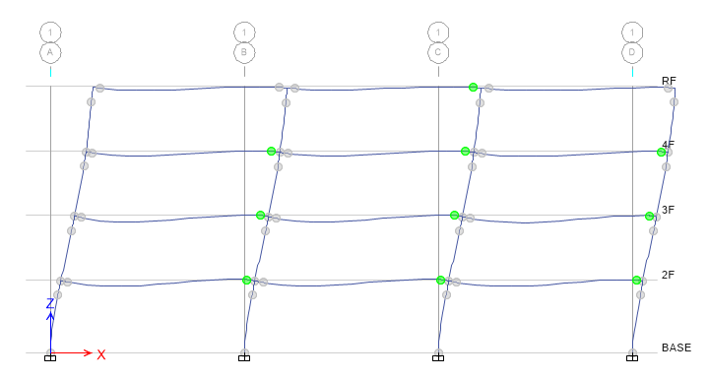
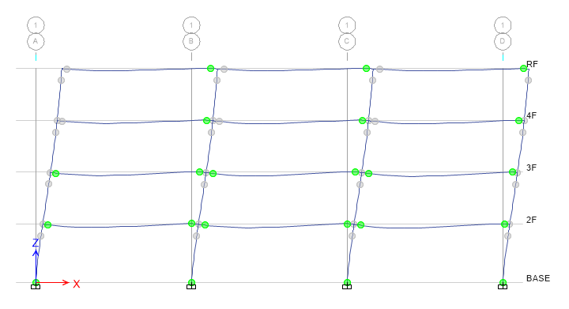
Step 3
Step 9

Slide 11
Modal Pushover Analysis

Slide 12
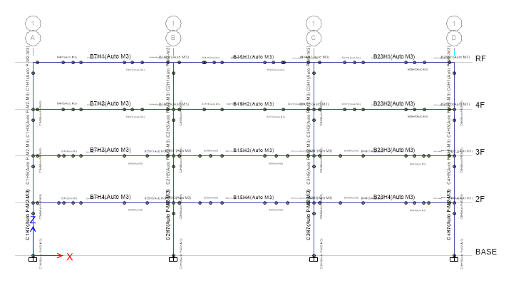
Multiple Hinges

Slide 13
Modal Pushover Analysis

Slide 14
Multi-Modes Combination

Slide 15
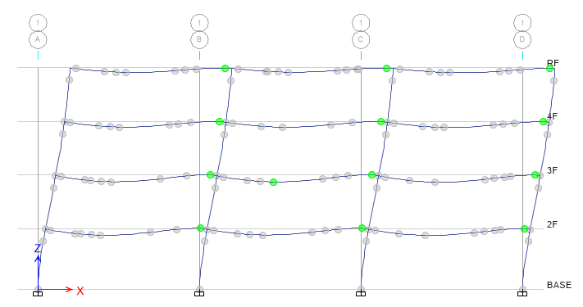
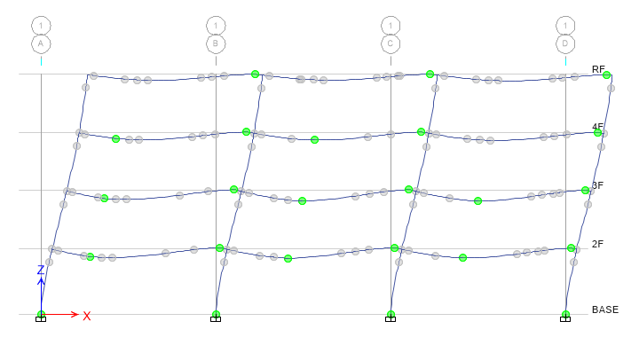
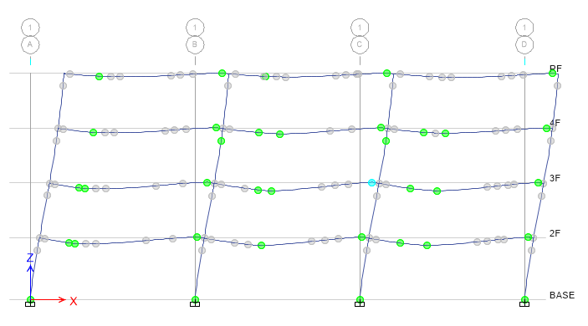
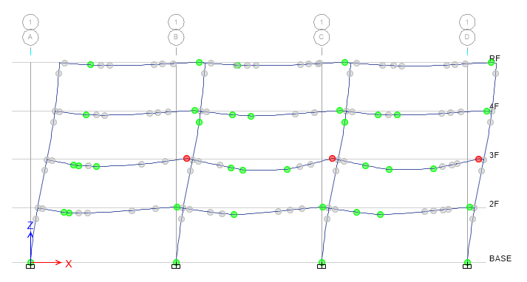
Step 3
Step 5
Step 7
Step 8

Slide 16
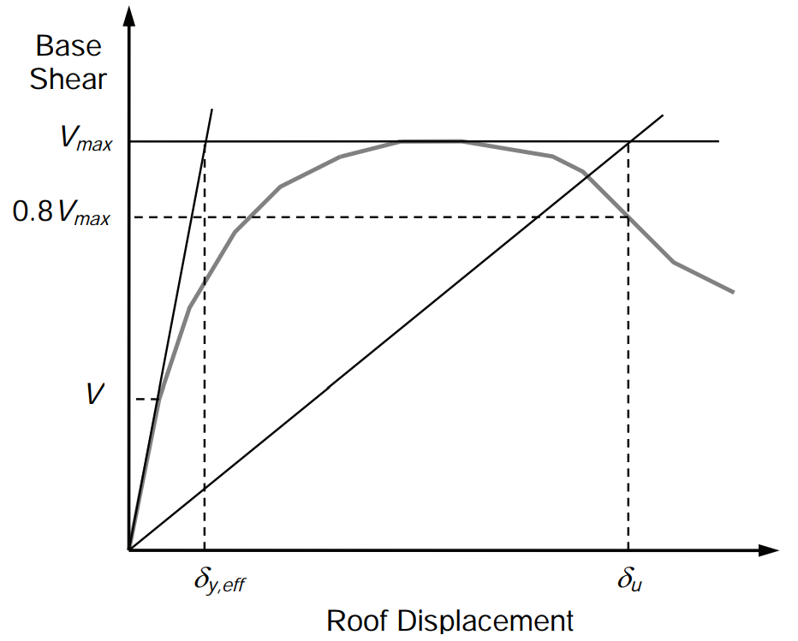
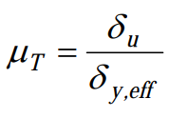
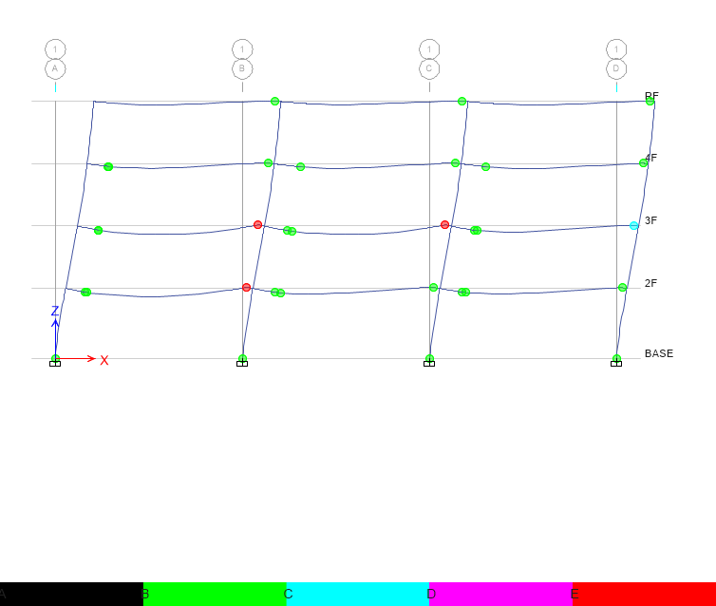
Pushover Result
Hinge
Notes:
比較 Ra, R 值
DBE, MCE 的性能績效點對應到 delta_u
雙線性化找到 delta_y,eff

Slide 17
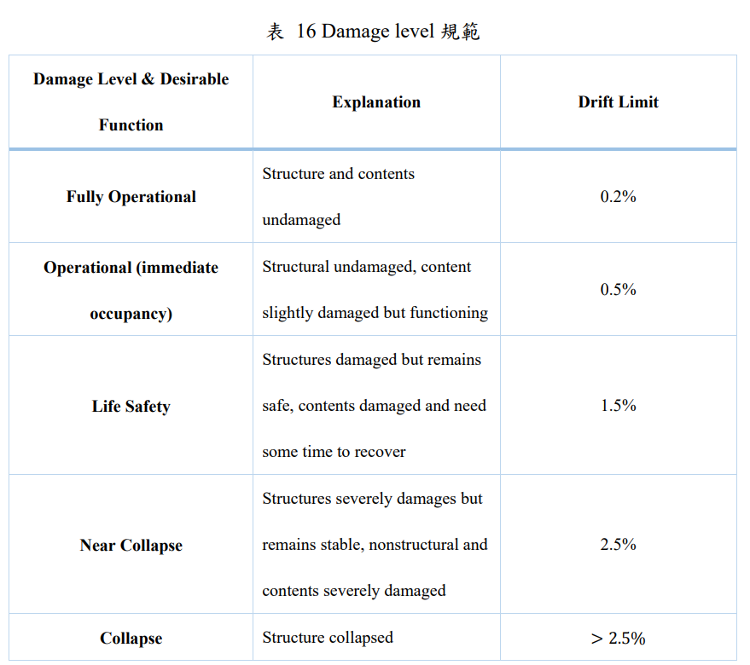
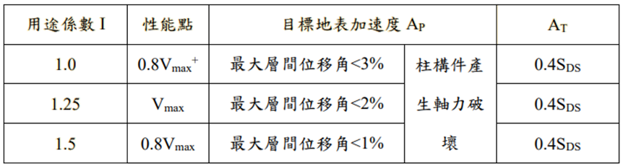
Pushover Result
耐震性能檢測 PGA
ATC-40

Slide 18
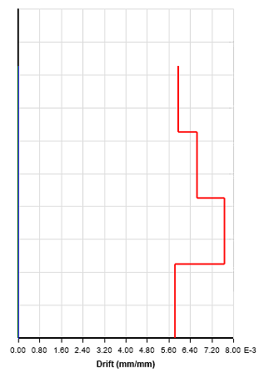
Time history
Story Drift
Scaled to DBE, MCE
DBE < 1.5%
MCE < 2%

Slide 19
Scaled

Slide 20
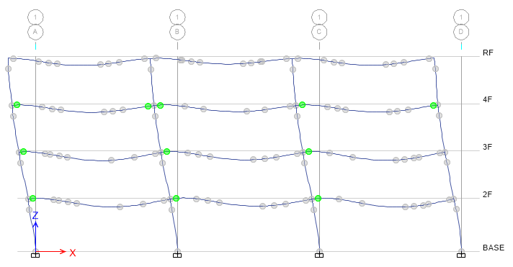
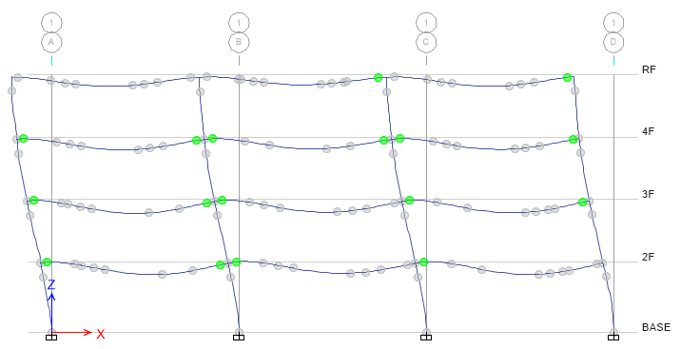
DBE
MCE

Slide 21
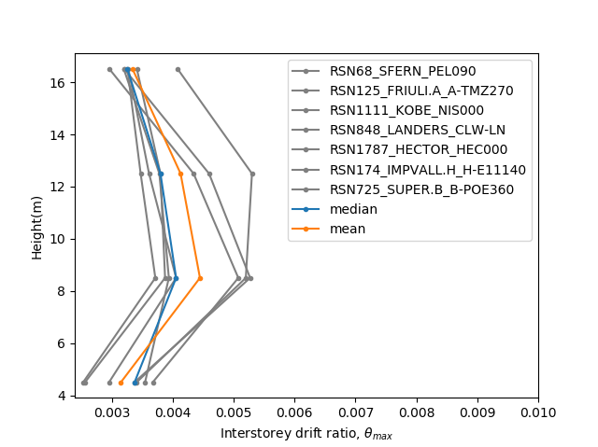
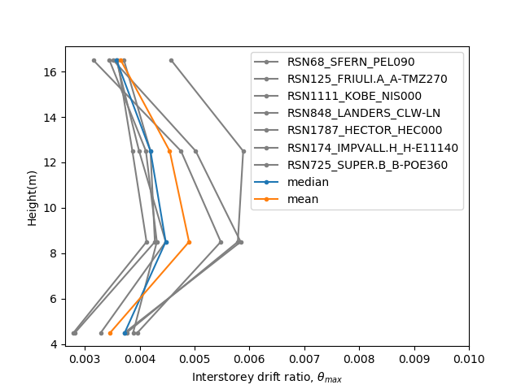
Hinges Only On Two Ends

Slide 22
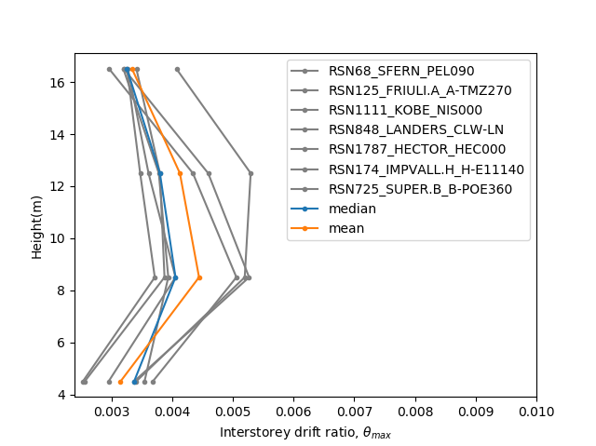

Multiple Hinges

Slide 23
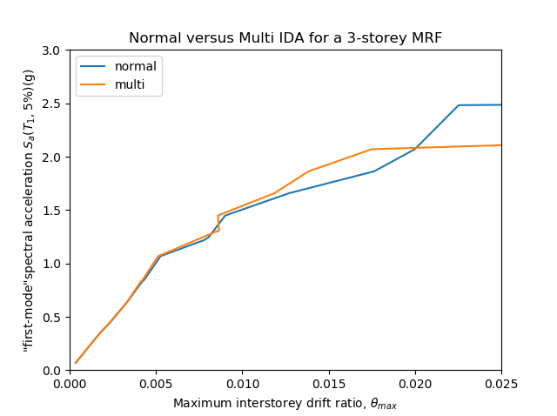
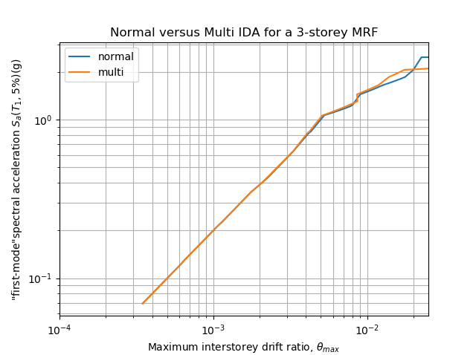
IDA
Limit-State
4% FEMA273
2.5% SEAOC 2000

Slide 24
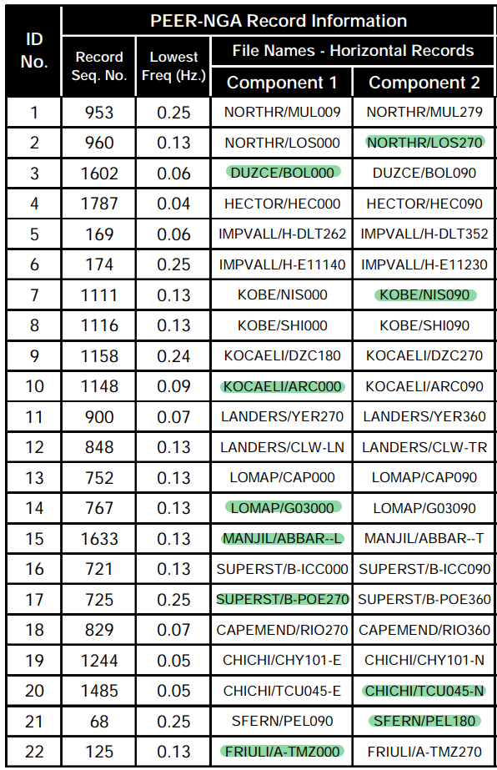
資料點數少
11 組

Slide 25
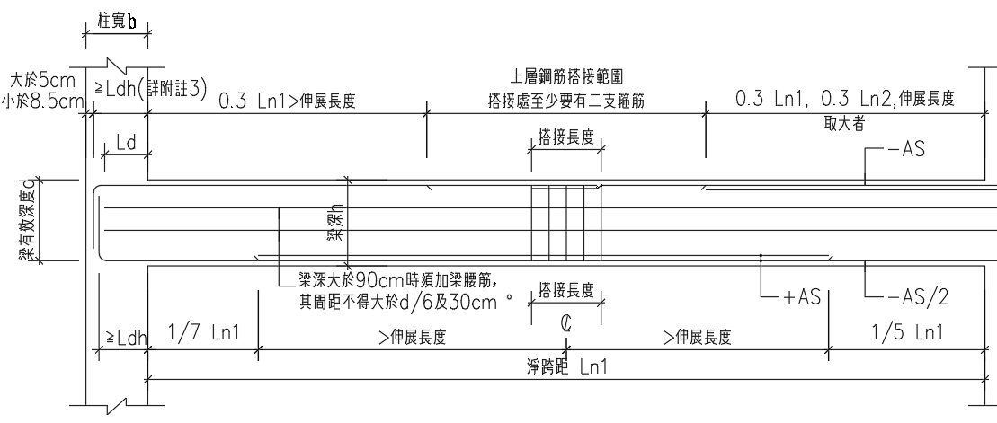
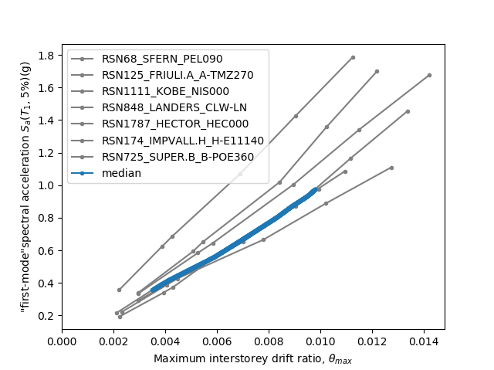
Hinges Only On Ends

Slide 26
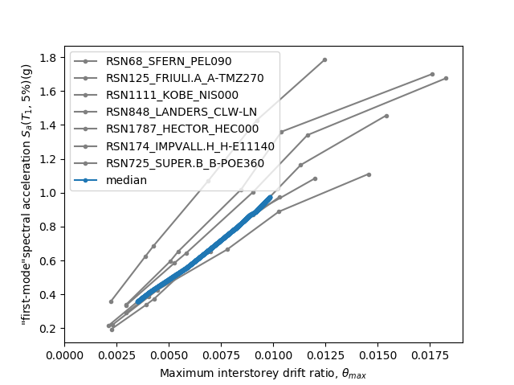
Multiple Hinges

Slide 27
Hinges Only On Ends
Multiple Hinges
0.014
0.017

Slide 28
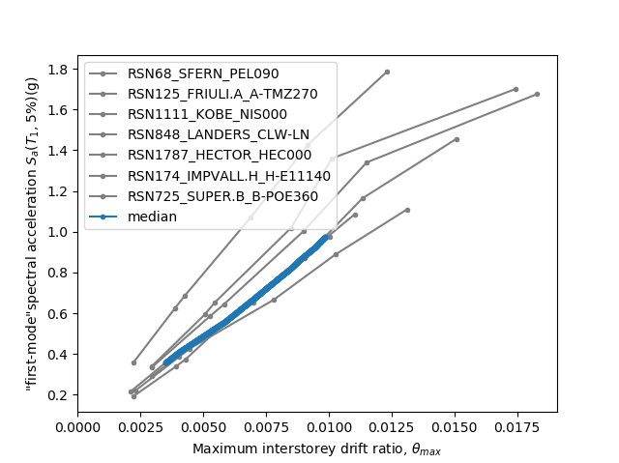
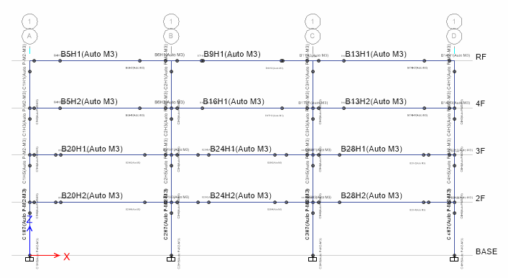
Normal Side

Slide 29

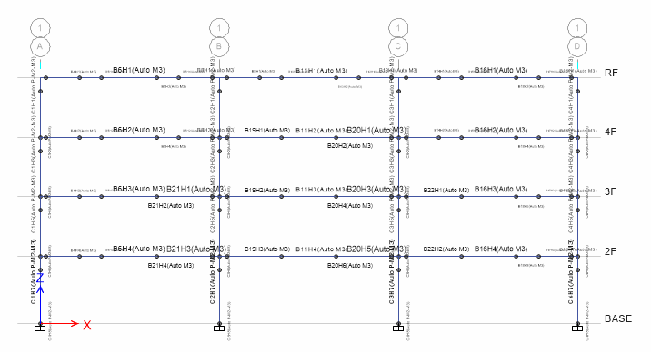
Normal NoLd

